Slide 1
MCTE 3104 Mechatronics Interfacing Lab
Session no. 3: Intro to Python

Slide 2
Outline
Intro to Python
Installation
Writing python codes
Examples of data types
Math libraries
Sequences
Intro to JSON

Slide 3
Intro to Python
The design focus on the Python language is on productivity and code readability, for example through:
• Interactive python console
• Very clear, readable syntax through whitespace indentation
• Strong introspection capabilities
• Full modularity, supporting hierarchical packages
• Exception-based error handling
• Good for rapid prototyping
• Has extensive scientific and machine learning libraries

Slide 4
Installation
Follow instructions here
https://github.com/cannedbot/MCTE3104-s1.1819/blob/master/setups/python-setup.pptx

Slide 5
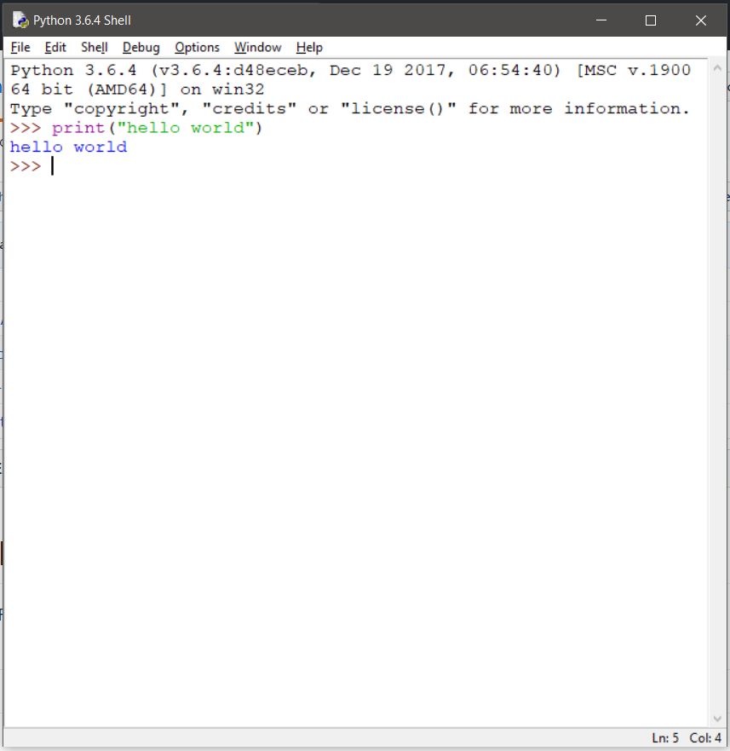
Writing Python Code
1 # Writing in a command line in python shell
Interactive shell for command-line interface. With ‘>>>’ at every line you enter you can write your python code. The advantage of writing the code like this is you can watch the result of every line instantly after you type.

Slide 6
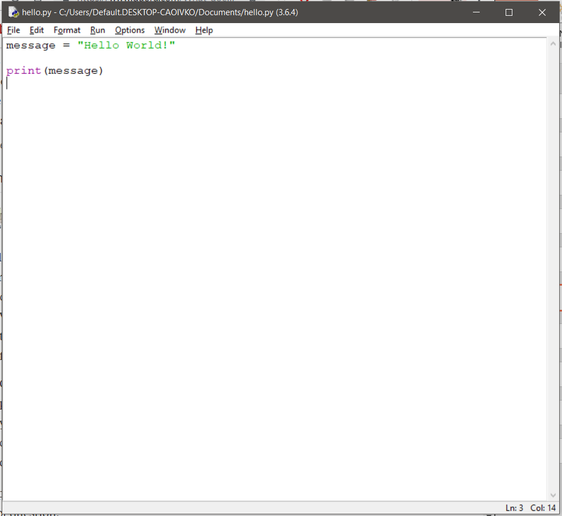
Writing Python Code
2 # Writing in a .py file and then run it
Writing your python code in a .py file and then allow python interpreter to run it. It will execute the whole .py file at the same time.

Slide 7
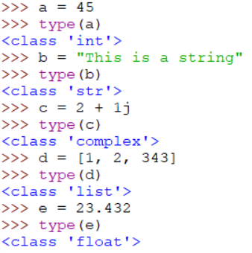

Data types
Example 1: Some examples of data types
Note: You can type these in the python shell

Slide 8
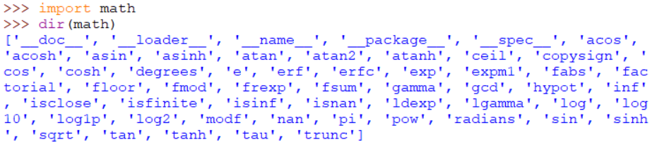
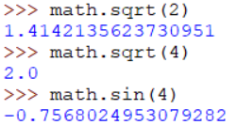
Maths
Example 2: Math libraries
Note: dir() function allows you to list down all the functions from a module (library)

Slide 9
Python
Lab activity 1:
Write a Python program to convert degree to radian. Save file in a .py file

Slide 10
Sequences
Commands | Actions
a[i] | returns i-th element of a
a[i:j] | returns elements i up to j − 1
len(a) | returns number of elements in sequence
min(a) | returns smallest value in sequence
max(a) | returns largest value in sequence
x | in a returns True if x is element in a
a + b | concatenates a and b
n * a | creates n copies of sequence a

Slide 11
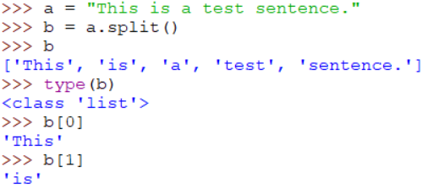
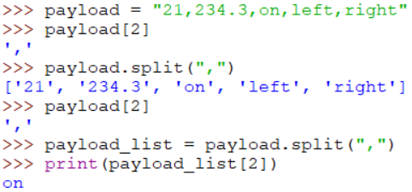
Sequences
Example 3: Char sequences
String is a good example of sequences. String is basically a sequences of characters.

Slide 12
Python
Lab activity 2:
Create a list of 30 items and print all elements with an even index number

Slide 13
Intro to JSON
Often times when you’re developing a system you’re required to work and manage data. One favourite format of serializing data is the JSON format. JSON (JavaScript Object Notation, which I pronounce "Jason" and you can pronounce however you like) is a text-based data format that's designed to be human-readable, lightweight, and easy to transmit between a server and a web client.
It is basically managing data by enclosing them with a combination of arrays and objects.
Arrays in JSON format looks like the following. Elements of the array can be a combination of many types.
[
"a",
"b",
"c",
"d",
"e",
"f"
]
[
"apple",
3,
912,
null,
-7.2222202,
"#",
true,
false
]
Array with single type data
Array with multiple type data

Slide 14
Intro to JSON
Arrays in JSON format looks like the following. Elements of the array can be a combination of many types.
[
"apple",
3,
912,
null,
-7.2222202,
"#",
true,
false
]
[
"a",
"b",
"c",
"d",
"e",
"f"
]

Slide 15
Intro to JSON
Objects in JSON format is composed of a key and it’s corresponding value.
{
"Alan": 44,
"John": 58,
"Brian": 19,
"Eliza": 4,
"Jessie": 58
}
{
“pressure_sensor": 234,
“temperature_sensor": 45,
“Switch": “On”,
“potentiometer_reading": 432,
}
Key = “Alan”
Value = 44
Key = “pressure_sensor”
Value = 234

Slide 16
Nesting
{
"device1":{
"pressure_sensor":234,
"temperature_sensor":45,
"Switch":"On",
"potentiometer_reading":432,
"read_history":[
123,
231,
354,
243
]
}
}
Nesting is when you make a combination of arrays and objects.
Key = “device1”
Value = “:{
"pressure_sensor":234,
"temperature_sensor":45,
"Switch":"On",
"potentiometer_reading":432,
"read_history":[
123,
231,
354,
243
]
}”

Slide 17
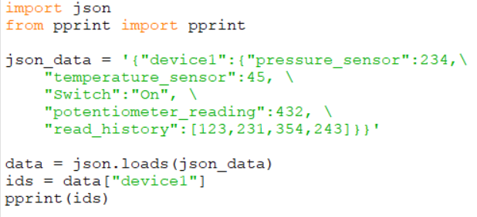
Reading JSON
Example 4: Reading JSON
Note: json.loads takes in a string as its first parameter.

Slide 18
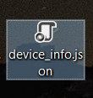
JSON file
{
"device1":{
"pressure_sensor":234,
"temperature_sensor":45,
"Switch":"On",
"potentiometer_reading":432,
"read_history":[
123,
231,
354,
243
]
}
}
This JSON can be saved in a .json file extension. Say we copy paste the JSON data and save it as device_info.json

Slide 19
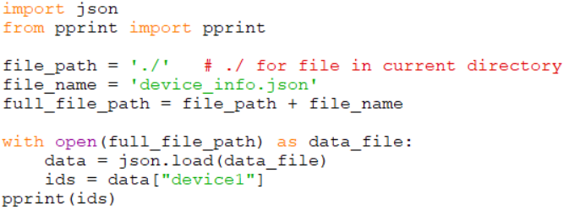
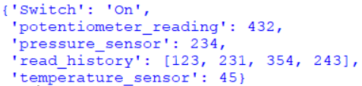
Reading JSON file
Example 5: Reading JSON file
Output:
Note: json.load (without the ‘s’) takes file pointer.

Slide 20
Python
Lab activity 3:
Imagine you were to build a home automation. You assign a node called ‘device-1’ that collect multiple sensor data for room one and a node called ‘device-2’ that collect multiple sensor data for room two. Structure your own json file format that combines both ‘device-1’ and ‘device-2’ data in a .json file.

